Slide 1

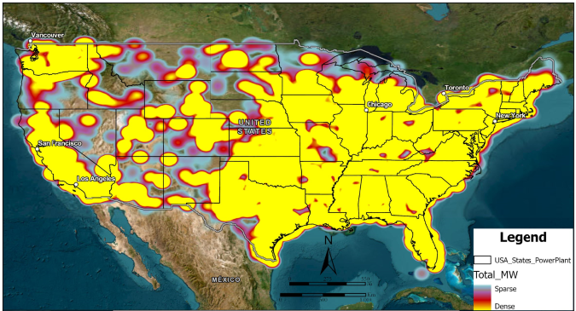
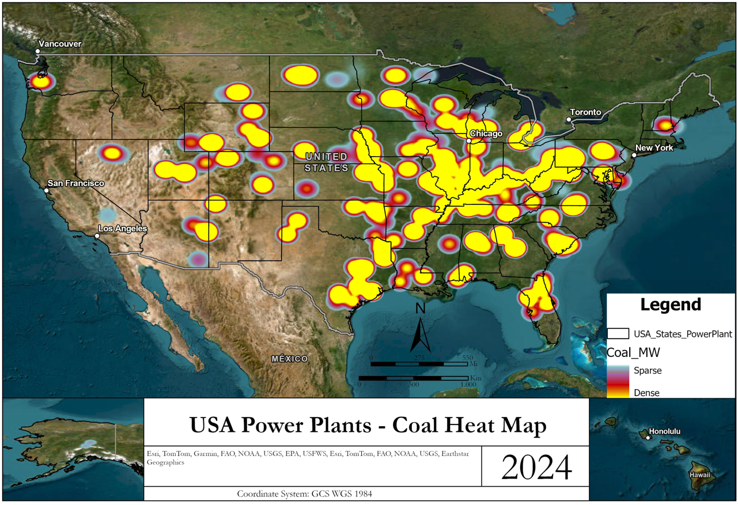
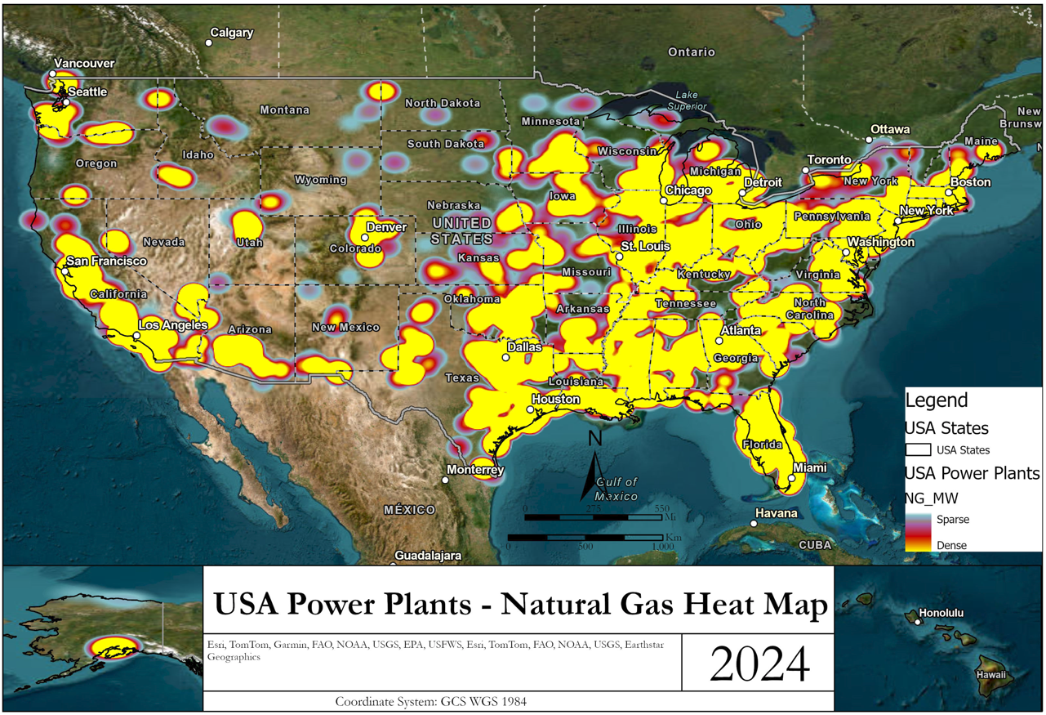
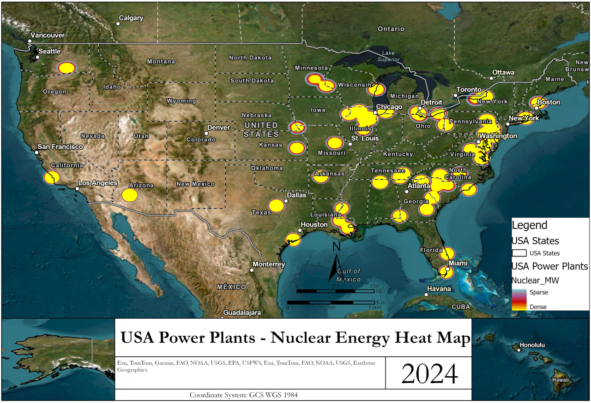
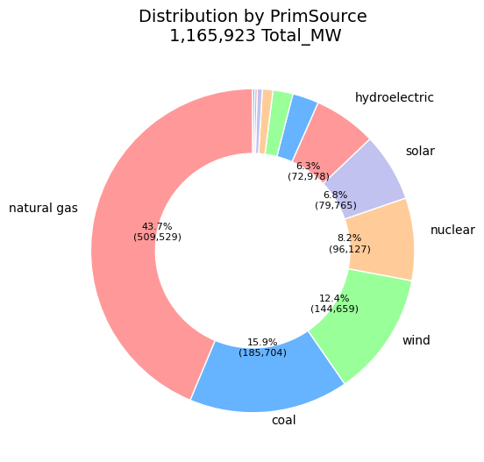
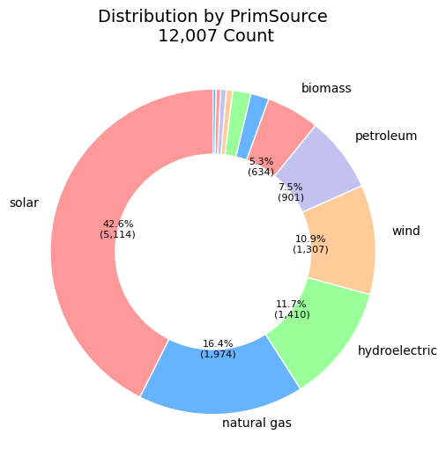
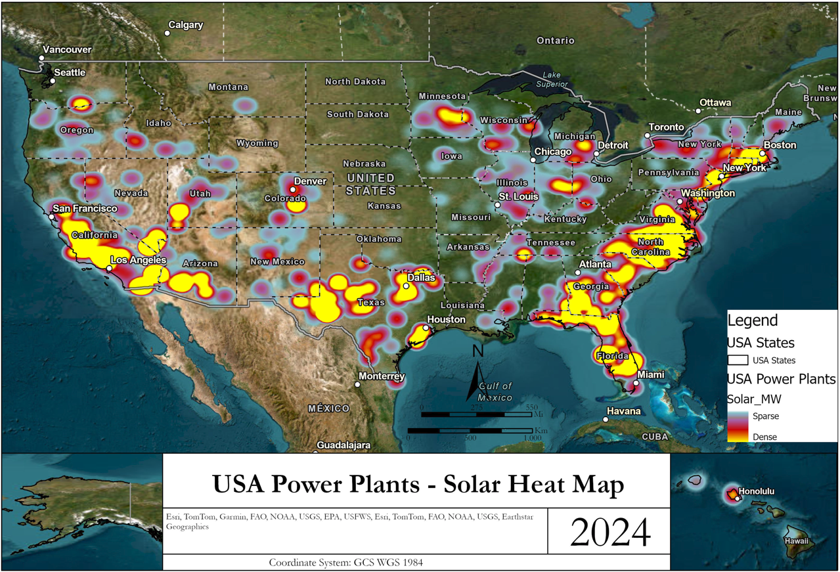
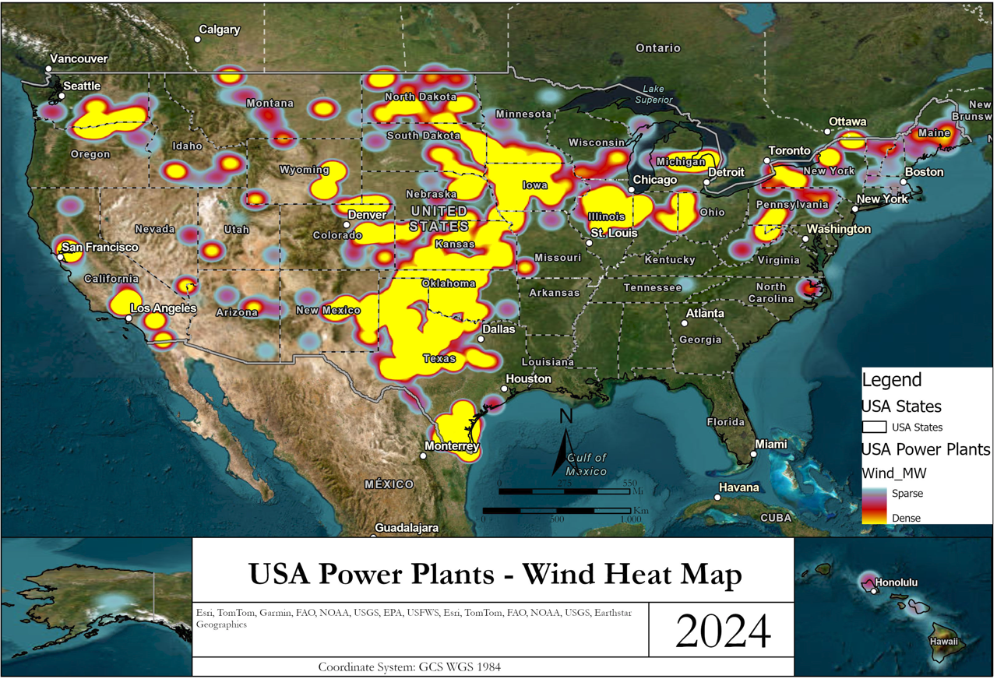
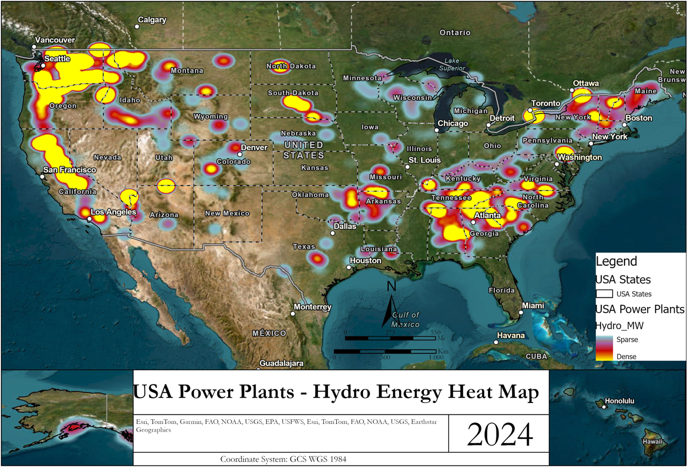
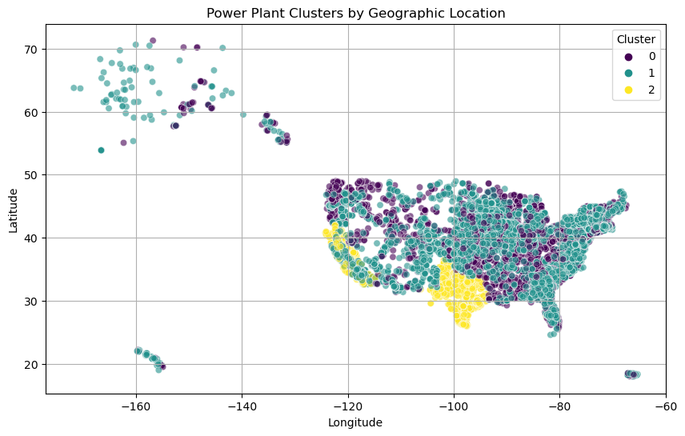
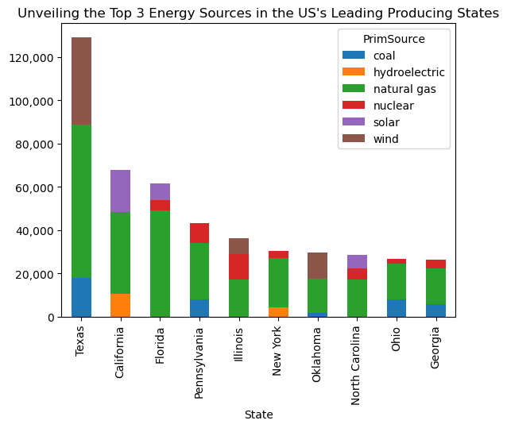
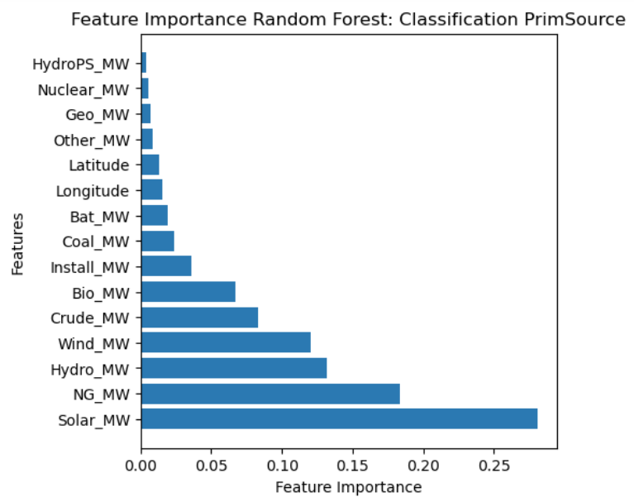
Analysis of Power Plant Energy Generation in the United States using Machine Learning and Geographic Information System (GIS)
Cristian C Noriega M, Blessing Austin-Gabriel, Ernest Chianumba, Rolih Ferdinand, Dr. Aparna Varde (School of Computing, and CESAC)
Goal
Non-renewable energy
While Natural Gas is leading energy source in the United States, renewable energy sources are poised for future dominance. We aim to analyze data on them.
The main goal is to study the distribution and classification of energy generation based on demographics and power source.
Renewable energy
Methods
Unsupervised machine learning using K-Means clustering to fathom how power generation areas are grouped.
Conclusions
Future work
Supervised machine learning using decision trees and random forest to classify the power sources.
The greatest energy producing source in the US is natural gas.
The greatest number of power plants are solar.
How can the energy distribution and findings be modeled using GIS in a user-friendly and interactive manner?
Address CO2 emissions with respect to transition towards cleaner energy, and the demographics.
Decision Trees & Random Forest: What exactly is causing these & why?
Data source
The U.S Energy Information Administration, May 2023

